Slide 1
Employee Pay Estimator
CAPSTONE PROJECT
Presented By:
Saathvik K
VIT(VELLORE INSTITUTE OF TECHNOLOGY)
BTech

Slide 2
OUTLINE
Problem Statement (Should not include solution)
System Development Approach (Technology Used)
Algorithm & Deployment (Step by Step Procedure)
Result
Conclusion
Future Scope(Optional)
References

Slide 3
Problem Statement
This project focuses on predicting employee salaries. It analyzes various features such as education level, age, work class, and occupation to estimate expected salary. Multiple models are trained and evaluated to identify the most effective one for salary prediction. The aim is to assist HR departments and companies in making data-driven compensation decisions.

Slide 4
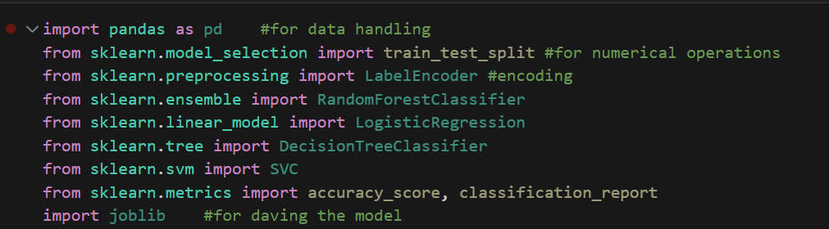
System Approach
System Requirements : Python Version: Python 3.7 or later
Software: Jupyter notebook/VSCode/Anaconda
Libraries To Build The Model:

Slide 5
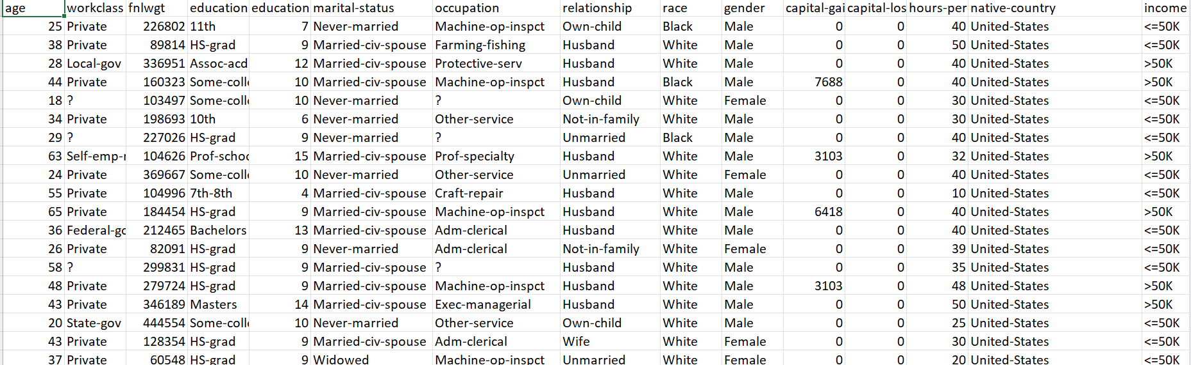
Algorithm & Deployment
1)Defining the Problem Statement: Predict whether an employee’s salary is >50K or <=50K using their personal and professional attributes.
2)Data Collection: Use datasets such as the Adult Income Dataset (used the data set provided by the mentor).

Slide 6
Algorithm & Deployment
.
3)Data Preprocessing:
a)Load data into pandas.
b)Drop unnecessary columns( eg: Education,fnlwgt,race)
c)Handle missing values.
d)Convert categorial data.
e)Remove outliers id necessary.
f)Split data into features.

Slide 7
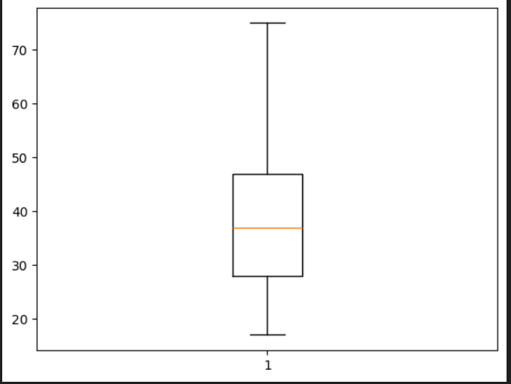
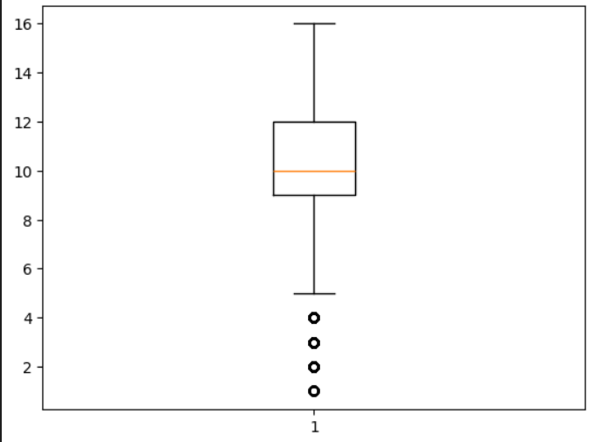
Algorithm & Deployment
4)Exploratory Data Analysis/Graphing:
- Use charts and graphs(matplotlib) to understand data
distribution.

Slide 8
Algorithm & Deployment
5)Split the Dataset:
Train-test split (e.g., 80% training, 20% testing).
6) Model Selection:
Choose classification models such as:
a)Logistic Regression
b)K-Nearest Neighbors (KNN)
c)Random Forest Classifier
d)Support Vector Machine (SVM)
e)Gradient Boosting Classifier

Slide 9
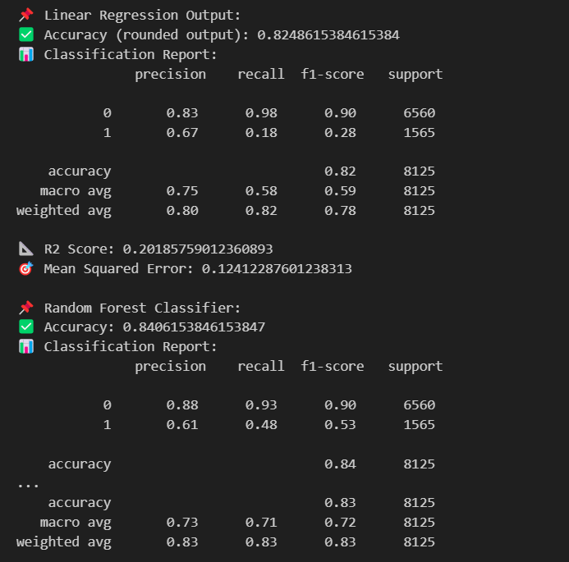
Algorithm & Deployment
7) Model Training:
Fit each model to the training data.
8) Model Evaluation:
- Predict on test data.
- Use metrics: Accuracy, Precision, Recall, Compare
performance of each model.

Slide 10
Algorithm & Deployment
9) Model Optimization:
Cross-validation to validate results.
10) Final Model Selection:
Choose the best-performing model for deployment based on
evaluation metrics.
11) Build a User Interface:
Use Streamlit or Flask to build a simple UI for users to input
employee data and get salary predictions.

Slide 11
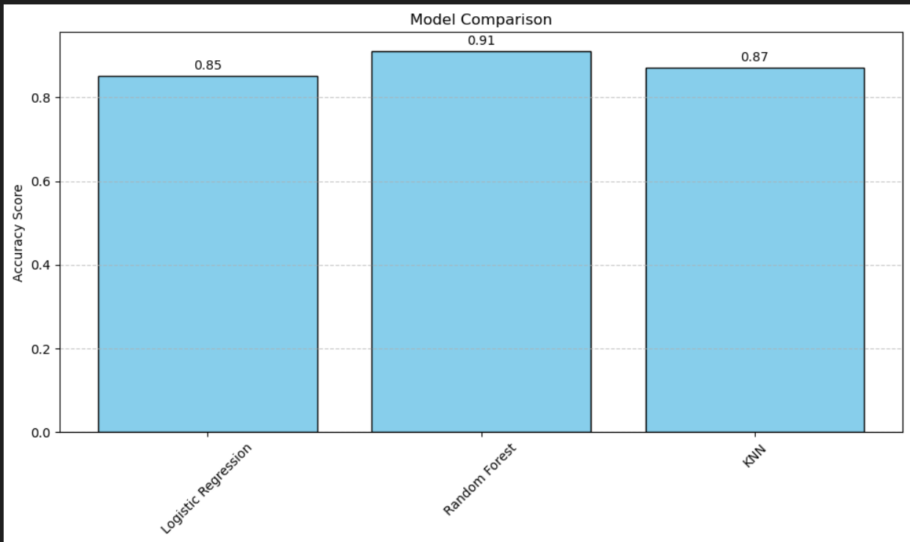
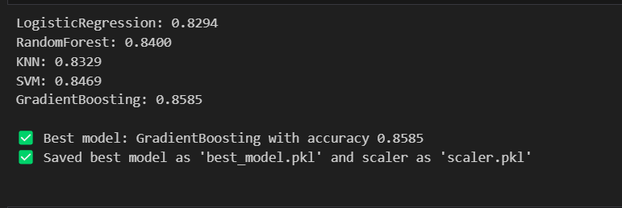
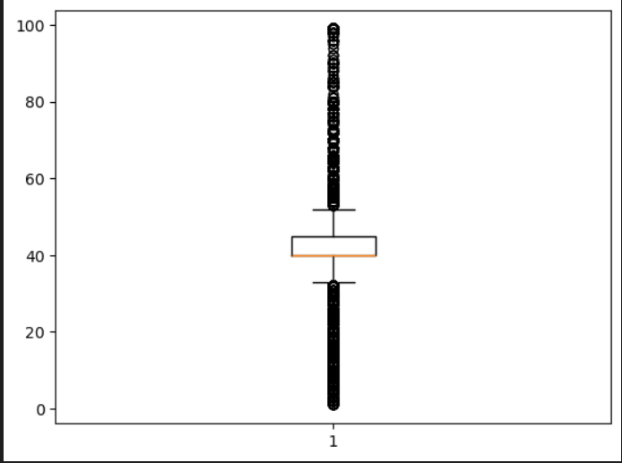
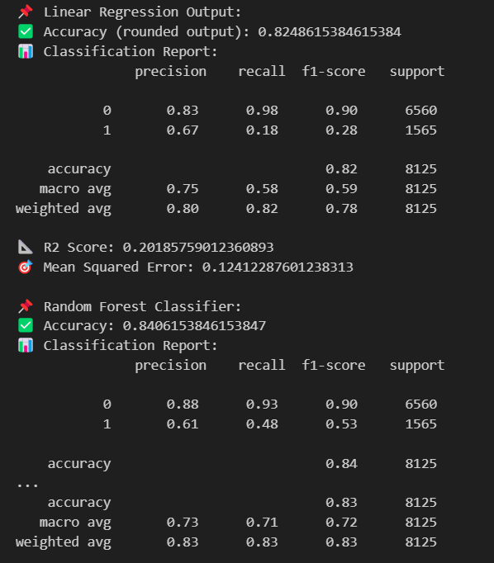
Result

Slide 12
Result
GITHUB LINK:

Slide 13
Conclusion
The Random Forest Classifier model was the best-performing model overall.
It achieved the highest accuracy and was the most balanced performance in precision, recall, and F1-score.
From the dataset, features such as education, hours worked per week, occupation, and workclass had the largest impact on predicting personal income over 50K.
Models such as Logistic Regression and KNN performed well, but not as well as random forest classifier ,they performed slightly lower than the other.

Slide 14
References
Machine Learning Algorithms – GeeksforGeeks
Installing AI/ML Python Libraries & Packages in Jupyter Notebook | Medium
Running AI/ML Algorithms in Python Jupyter | Medium
Data Preprocessing in Python: All important steps explained | by Anmol Hans | Nerd For Tech | Medium

Slide 15
THANK YOU

